Slide 1
ELC 4028
Artificial Neural Networks and its Applications by
Dr. Mona Riyad
Dr. Mohsen Rashwan

Slide 2
Introduction
Importance of Machine Learning and Artificial Intelligence

Slide 3
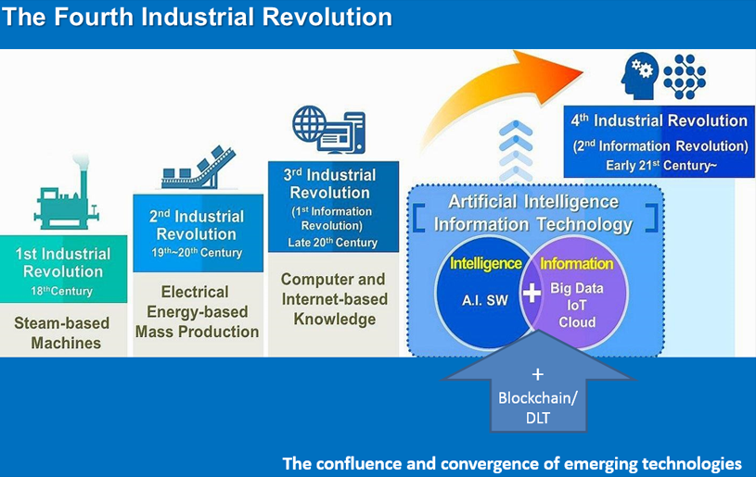
AI is the core of the 4th Industrial revolution

Slide 4
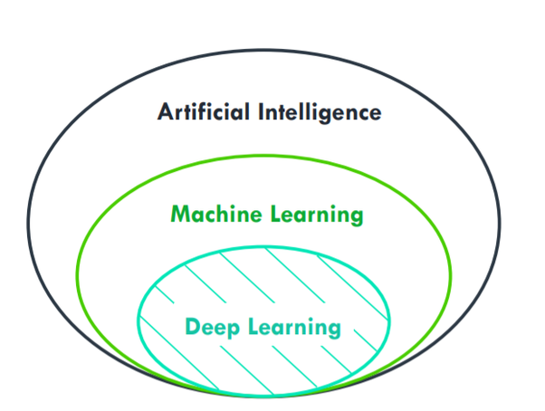

Slide 5
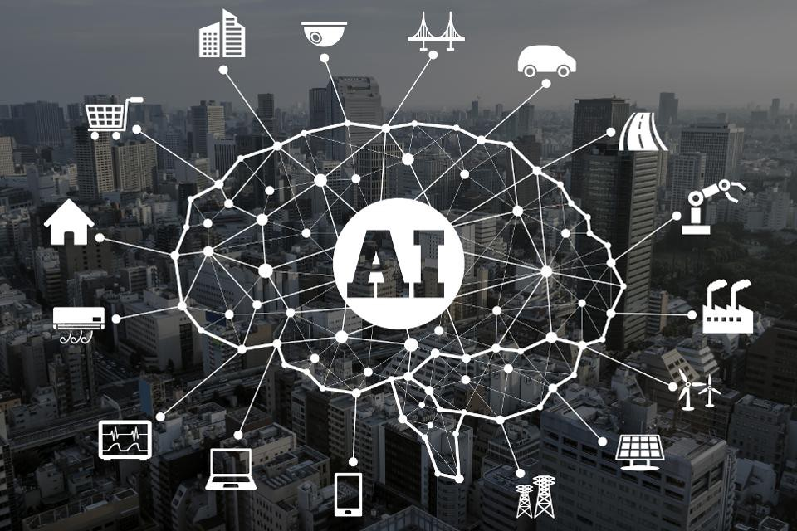
AI impact of Human Life

Slide 6
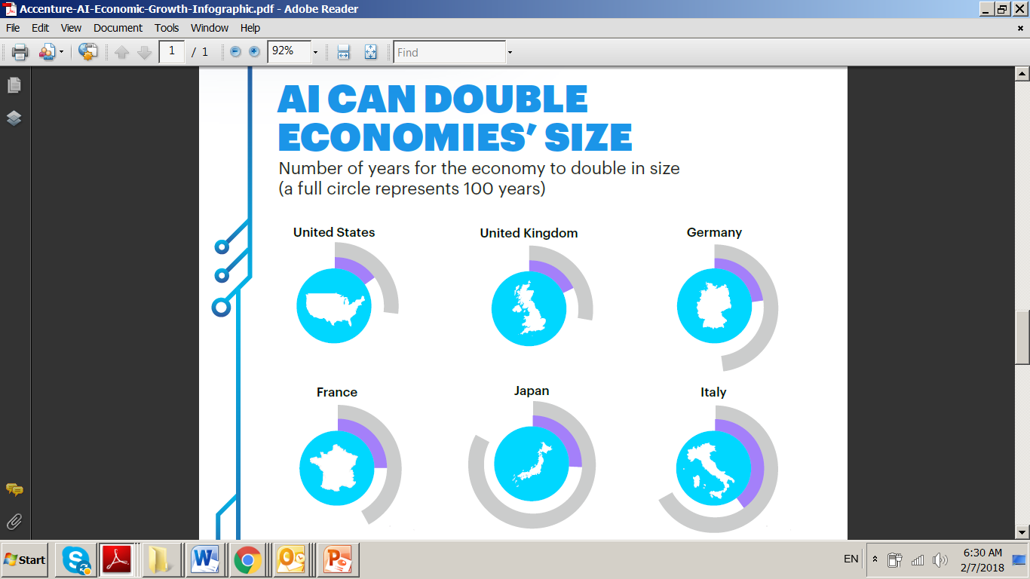

Slide 7
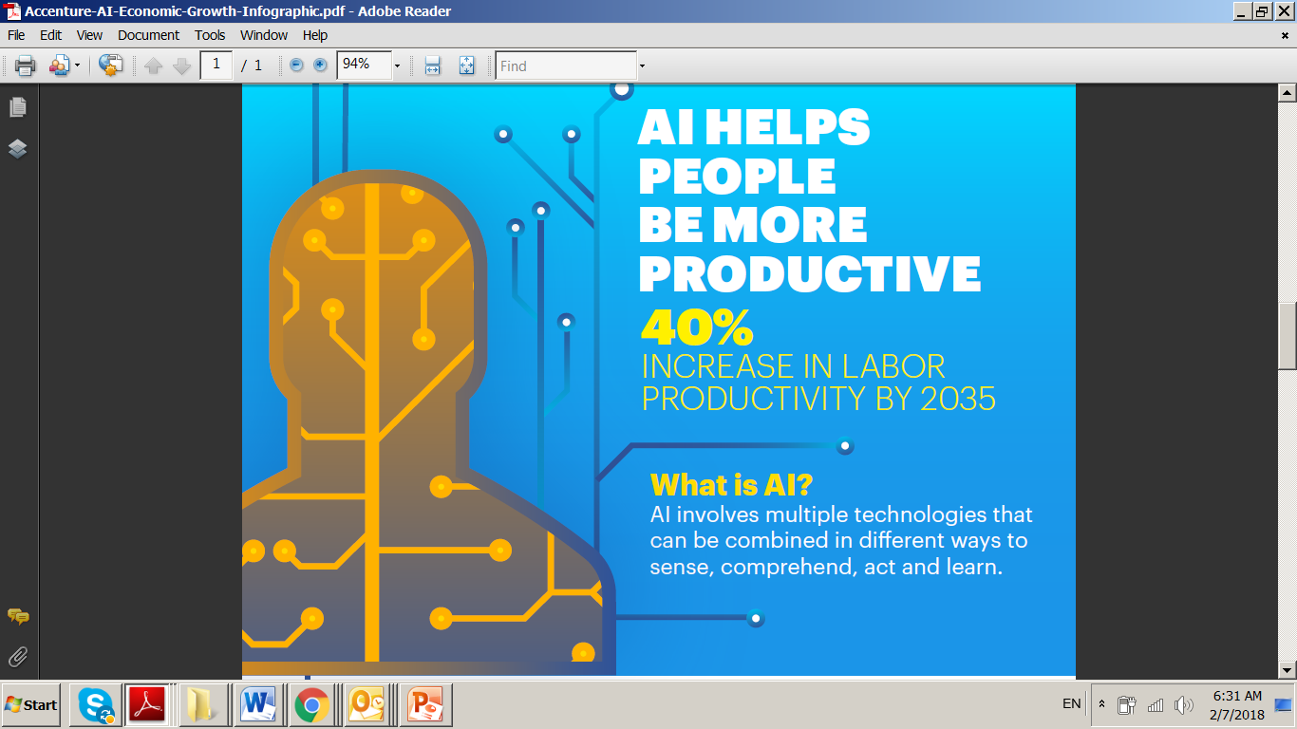

Slide 8
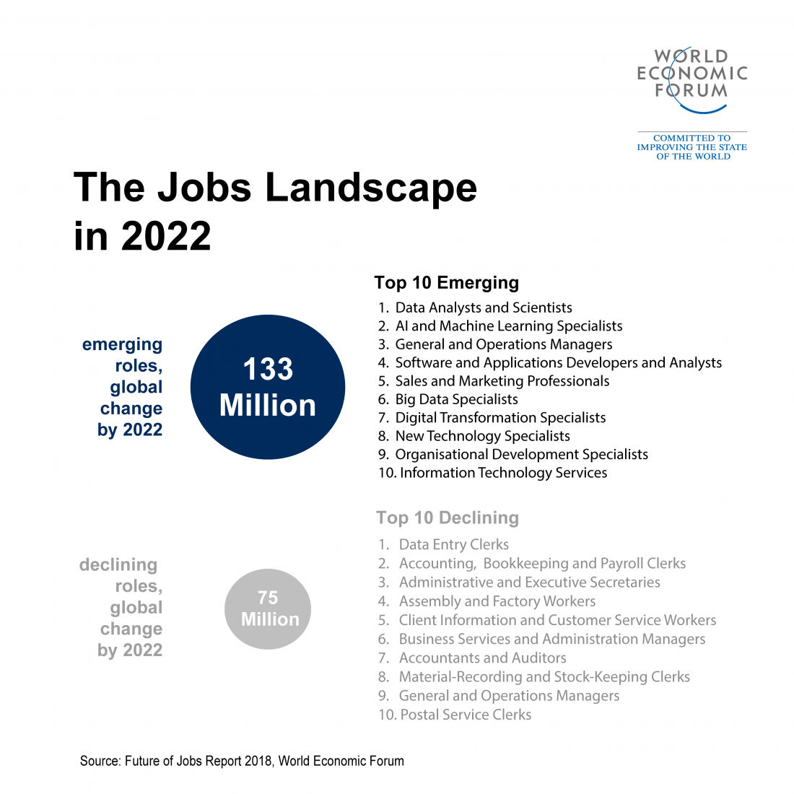

Slide 9
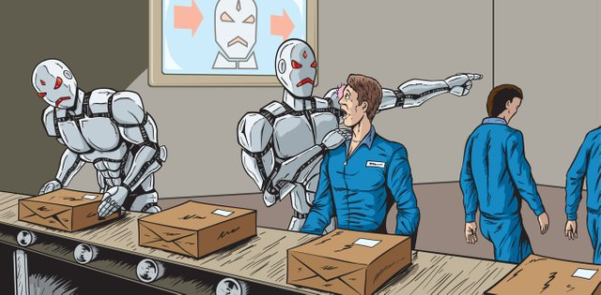
Many Jobs will disappear

Slide 10
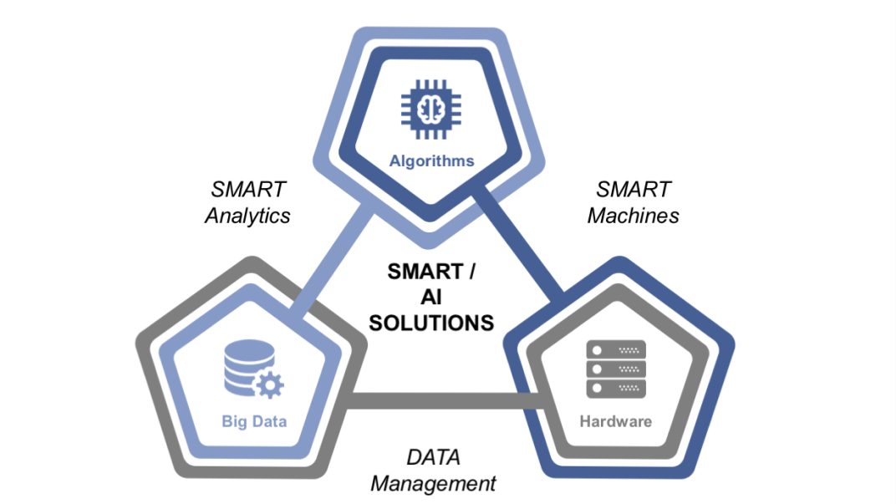
Factors enabling AI Growth (by Hardik Gohil)
Availability of huge Data
  Data is Gold
  World’s data doubles every 18 months
More advanced Algorithms
  Algorithms that suits the big data:
  More utilization of:
    Unsupervised algorithms
    Reinforcing algorithms
Better hardware & Cloud with AI
  Better GPUs and cheaper
  Increasing cloud with AI tools

Slide 11
Machine Learning

Slide 12
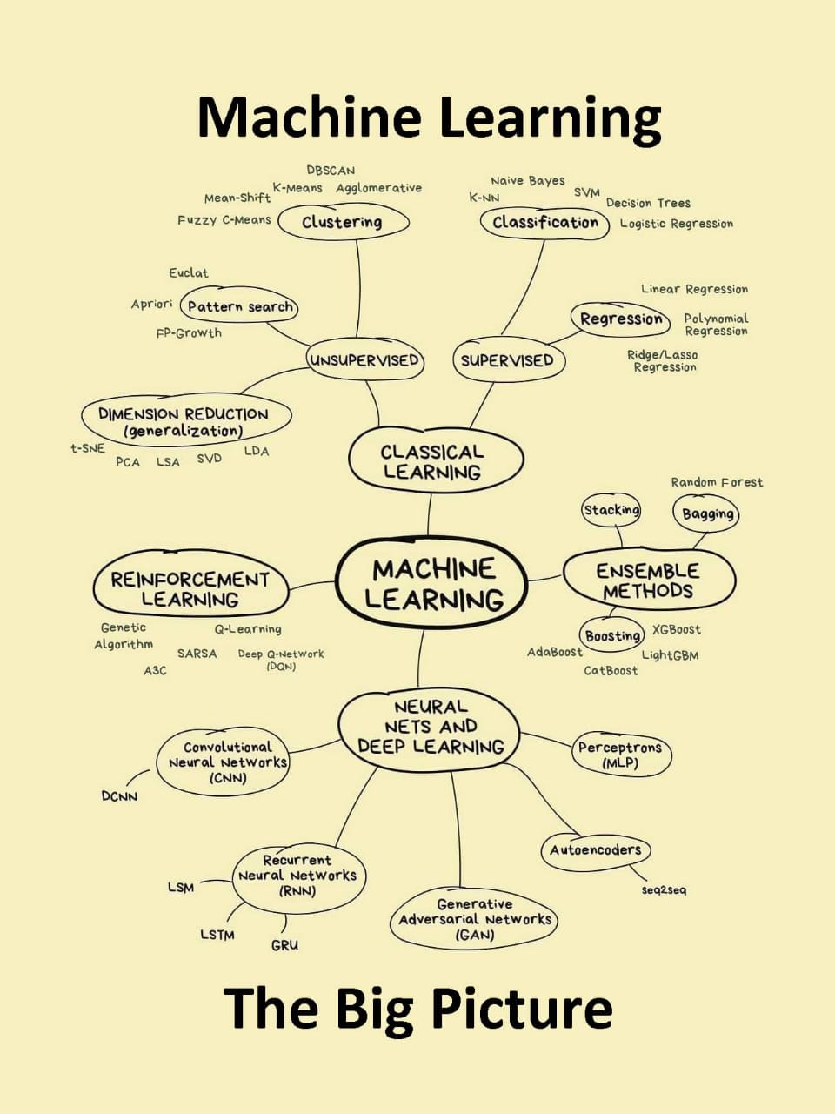

Slide 13
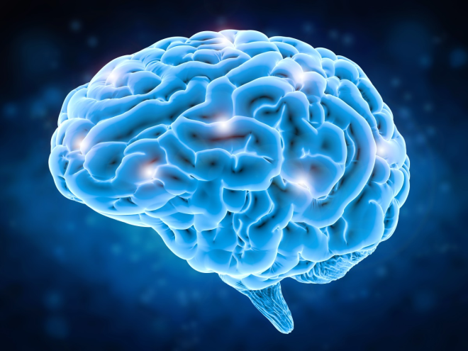
Many classifiers to choose from
Neural Network era

Slide 14
Brain and Machine
The Brain
  Pattern Recognition
  Association
  Complexity
  Noise Tolerance
The Machine
  Calculation
  Precision
  Logic

Slide 15
Contents of the first part
Introduction to NN
Single-layer perceptron
Multilayer perceptron
Back propagation algorithm
Convolutional Neural Network (CNN)
Learning Algorithms: supervised, unsupervised, reinforcement learning
Overfitting and how to avoid it

Slide 16
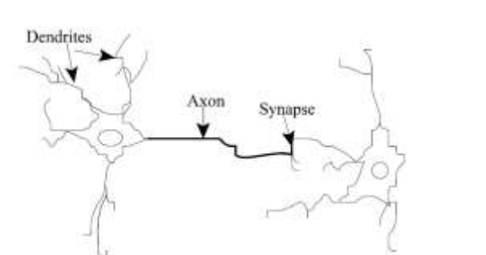
Introduction
Structure of biological neuron

Slide 17
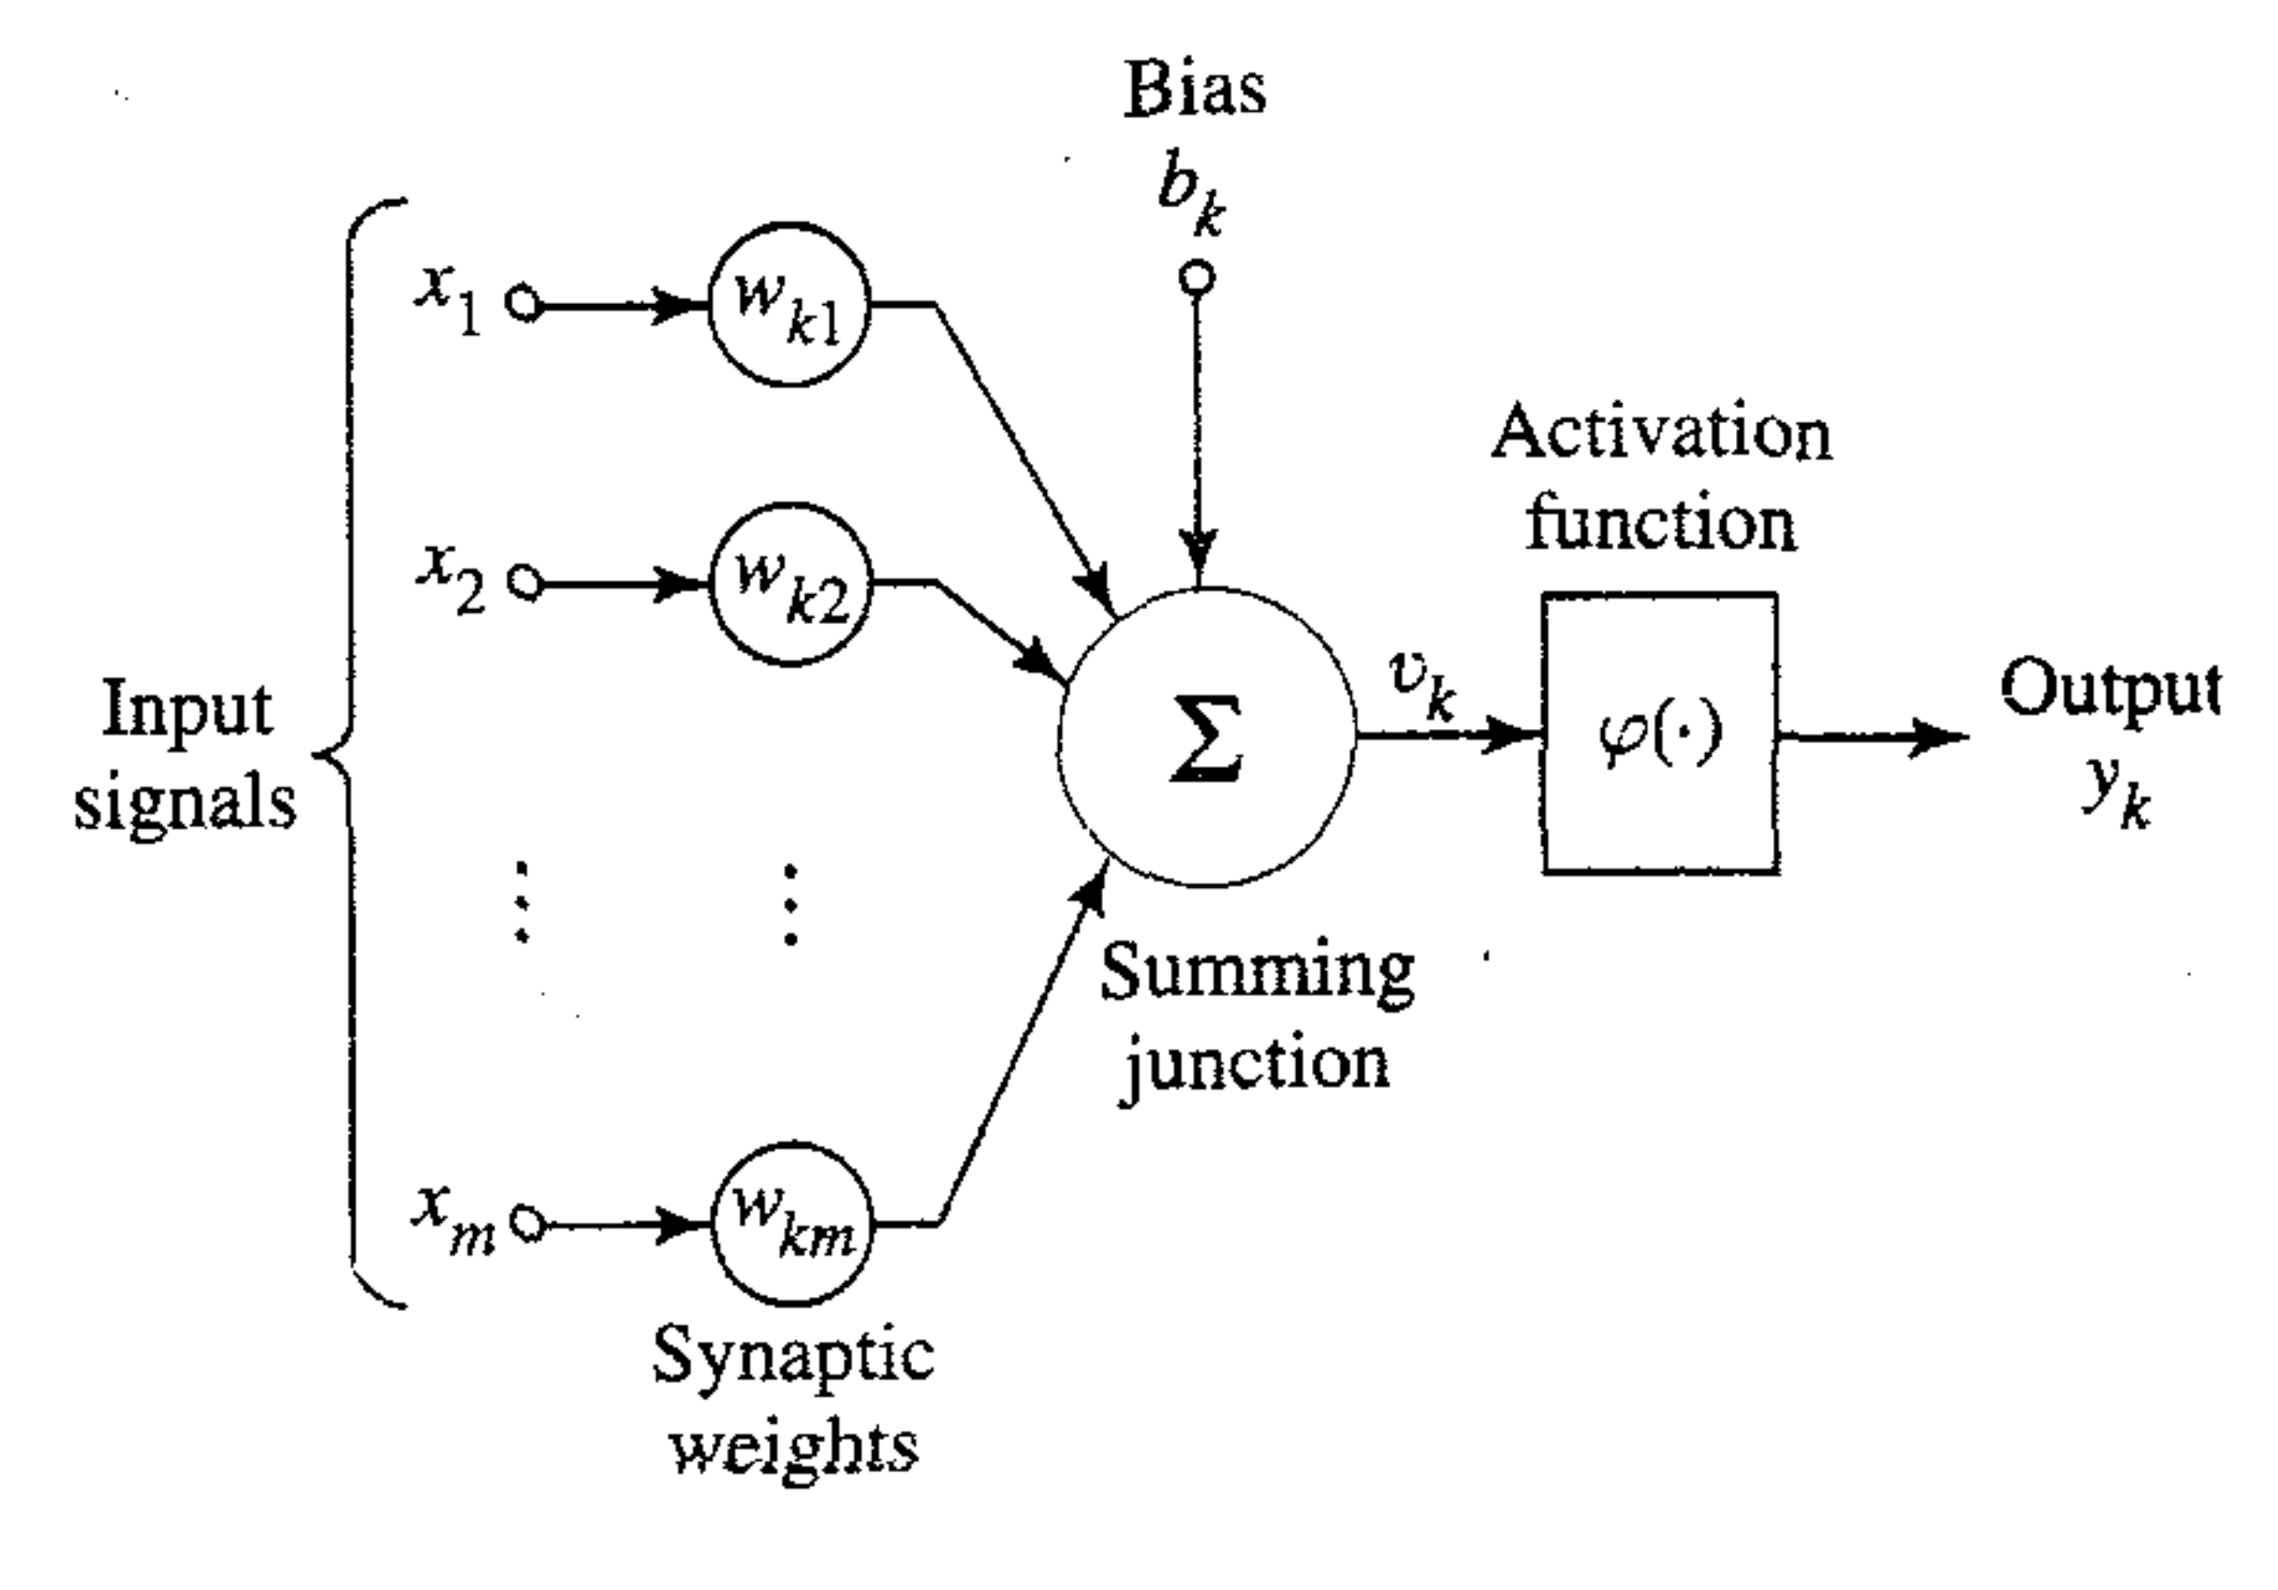
Artificial neuron

Slide 18
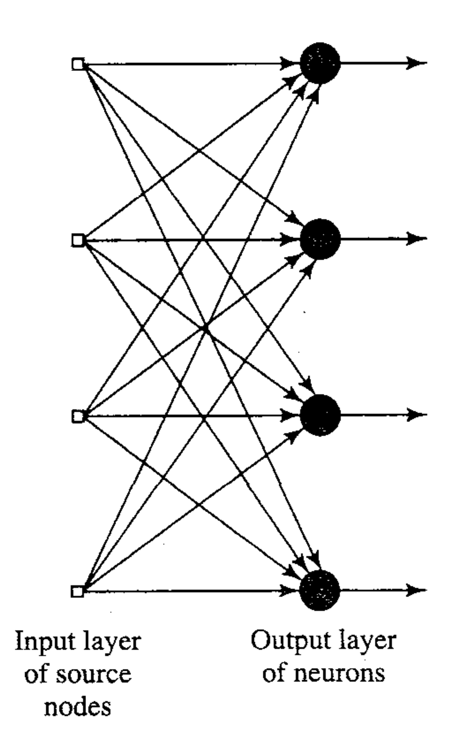
Neural Network Architectures
1- Single layer feedforward networks

Slide 19
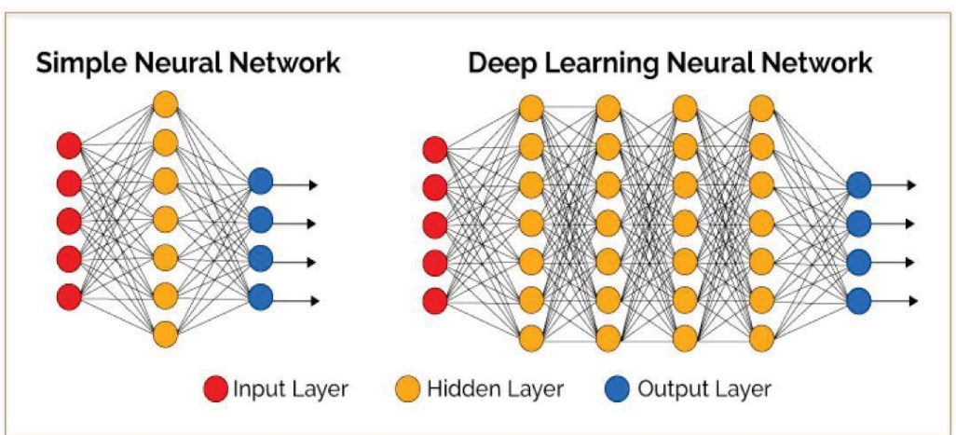
2- Multilayer feedforward networks

Slide 20
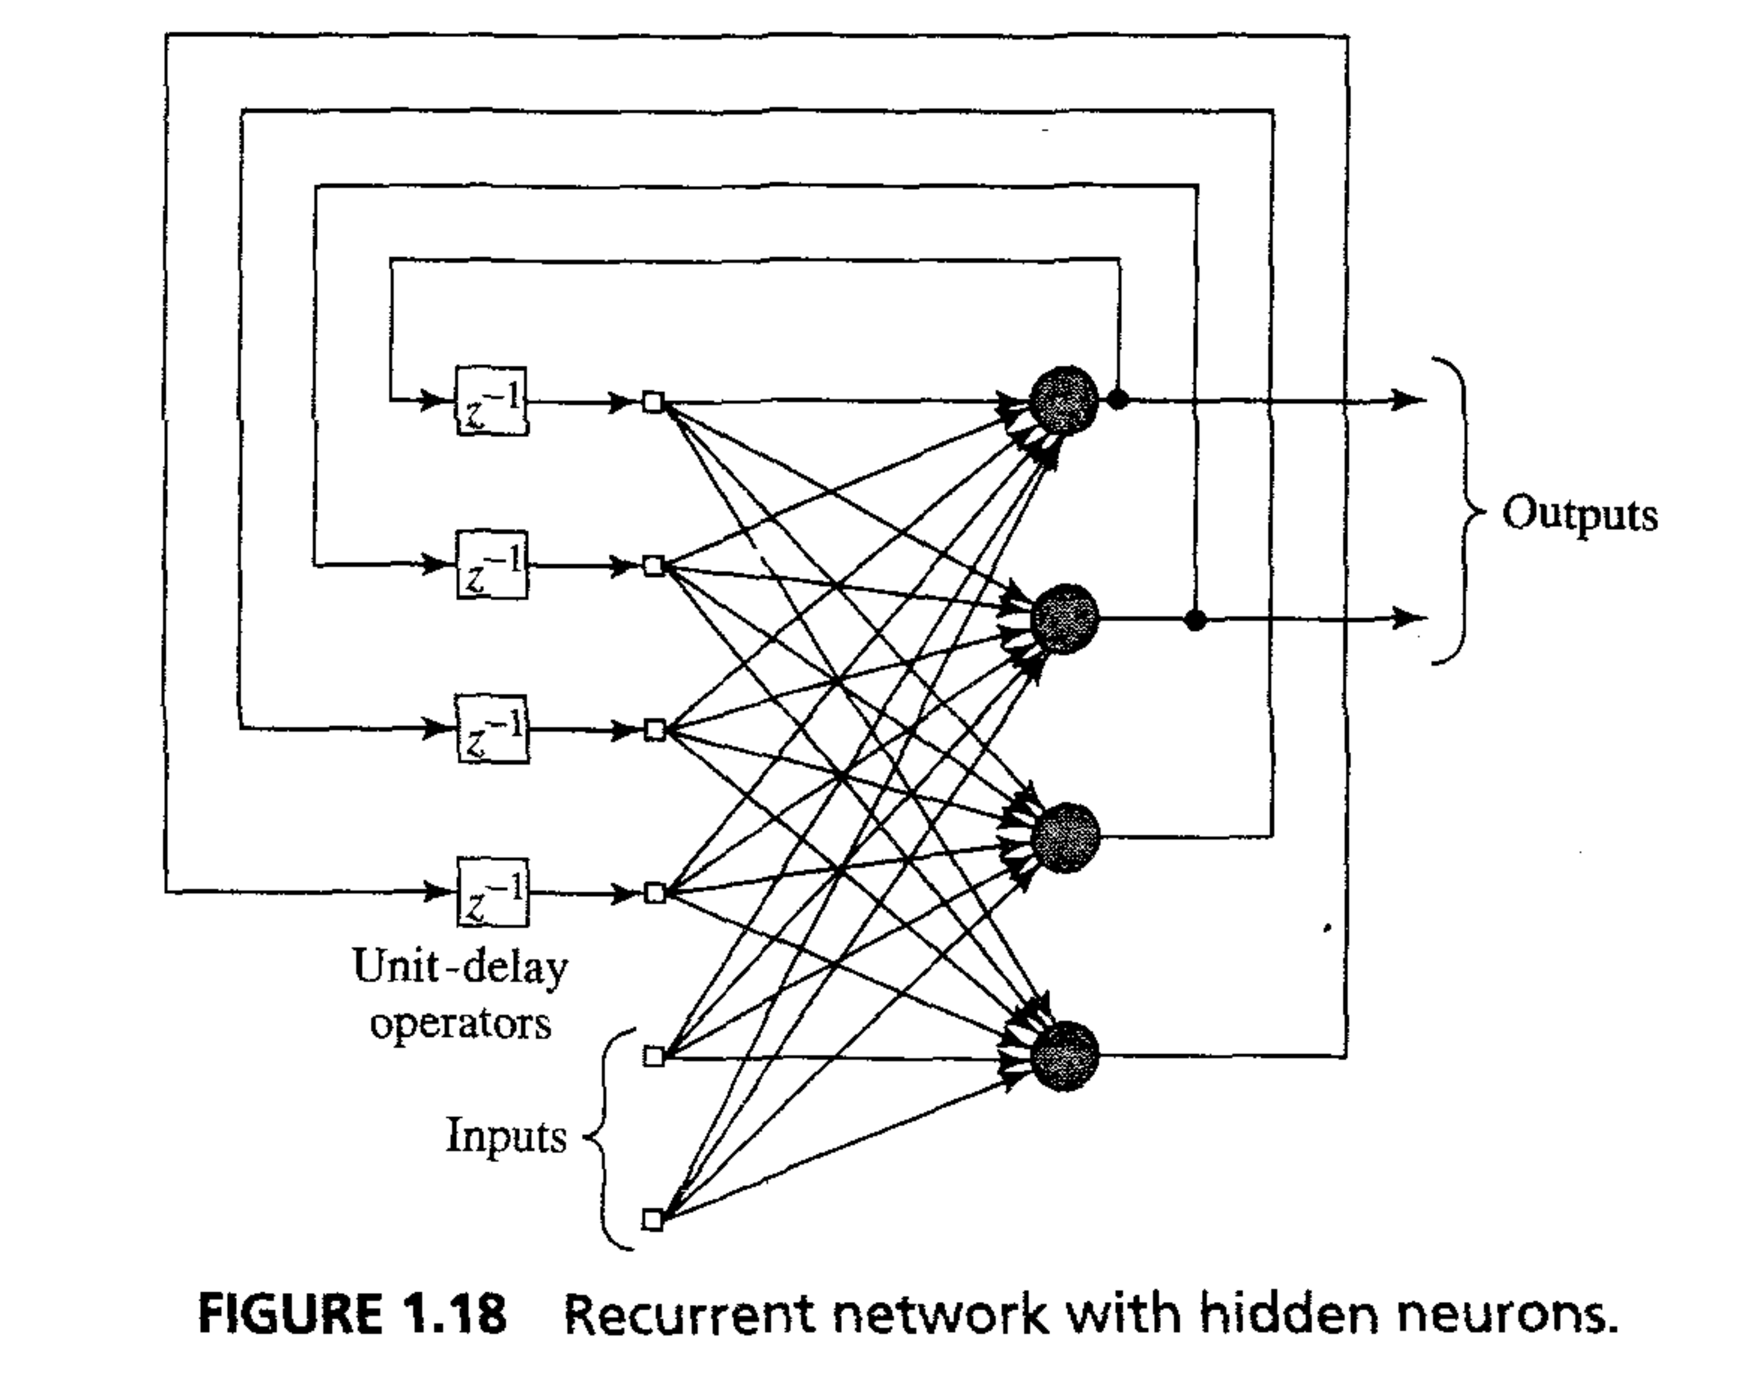
3- Recurrent Network (Hopfield NN)

Slide 21
Contents of the Second part
Introduction
Data preparation for machine learning
Classical machine learning techniques
Deep Neural Network Structures:
  CNN with its variants and ImageNet project
  Attention and Transformers
  Language Modeling: BERT and GPT projects (ChatGPT project and effect)
  GAN Models

Slide 22
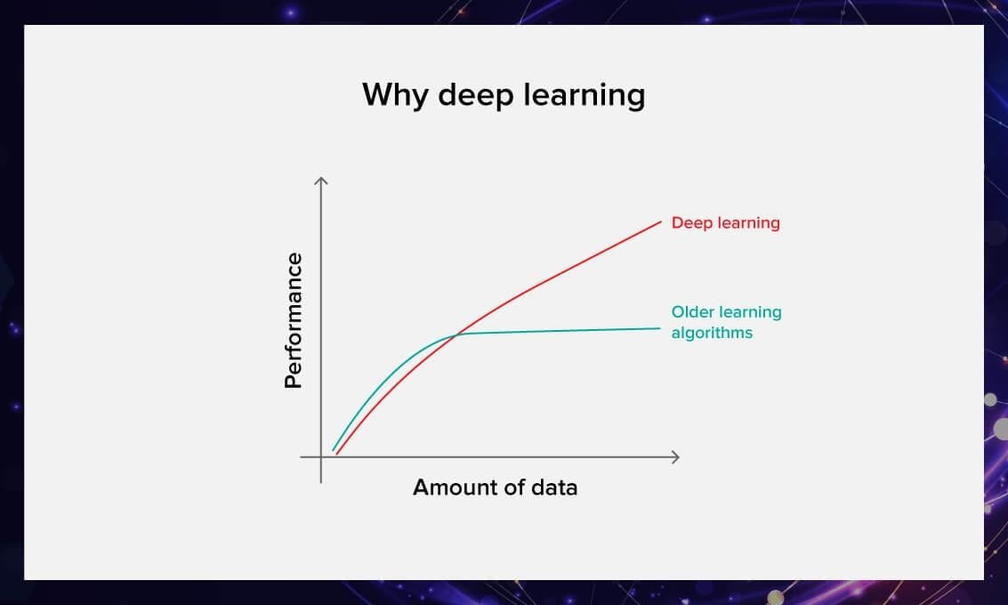

Slide 23
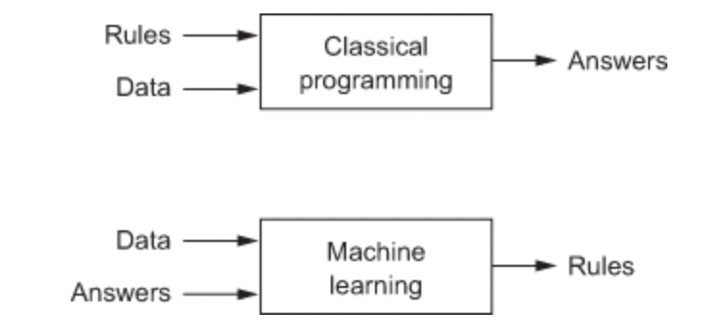
Machine Learning Between Classical and Deep learning

Slide 24
Data Preparation for Machine Learning
Data Collection
Data reduction techniques
K-means clustering, Gaussian Mixture Model
Principal Component Analysis
Data Cleansing

Slide 25
Many classifiers to choose from (Classical Techniques)
SVM
Naïve Bayes
Bayesian network
Logistic regression
Randomized Forests
Boosted Decision Trees
K-nearest neighbor
…etc.
Which is the best one?
x2
x
x
x
x
x
x
o
x
x
o
o
o
o
x1

Slide 26
Deep Learning
using
Deep Structures of Neural Network

Slide 27
Deep Neural Network Structures
CNN and its Variants

Slide 28
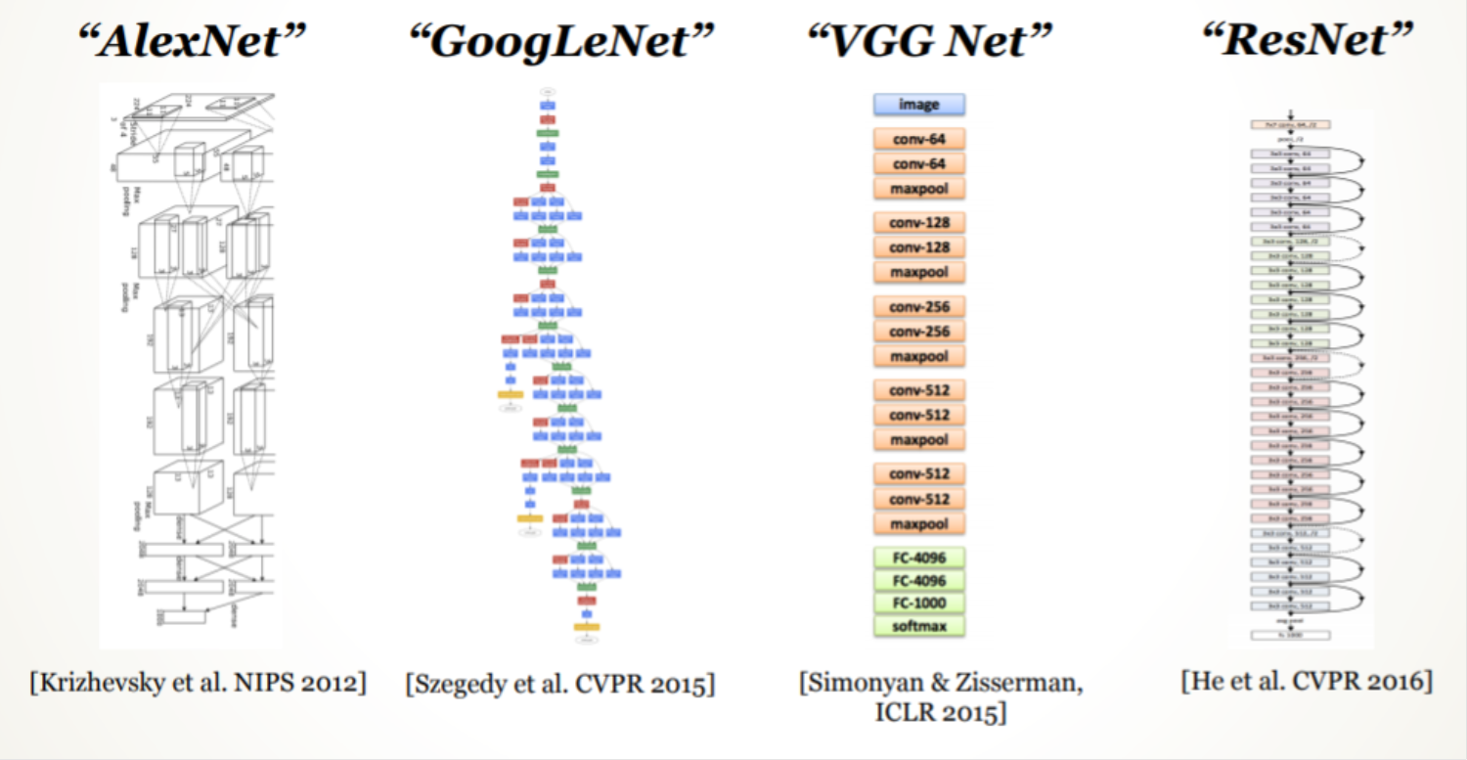
CNN and its Variants to deal with images (ImageNet Project)

Slide 29
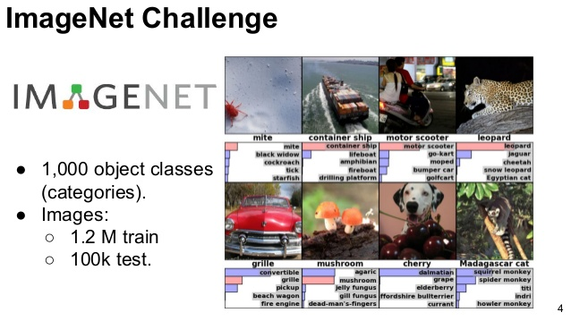
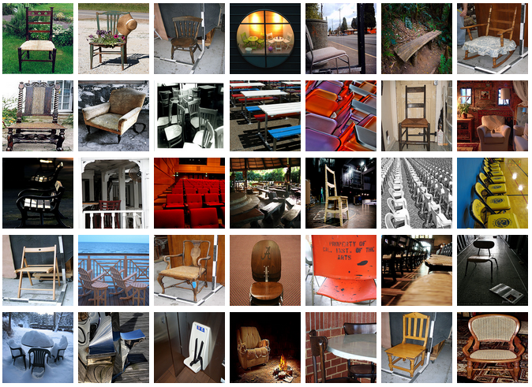
Useful in many Important Applications

Slide 30
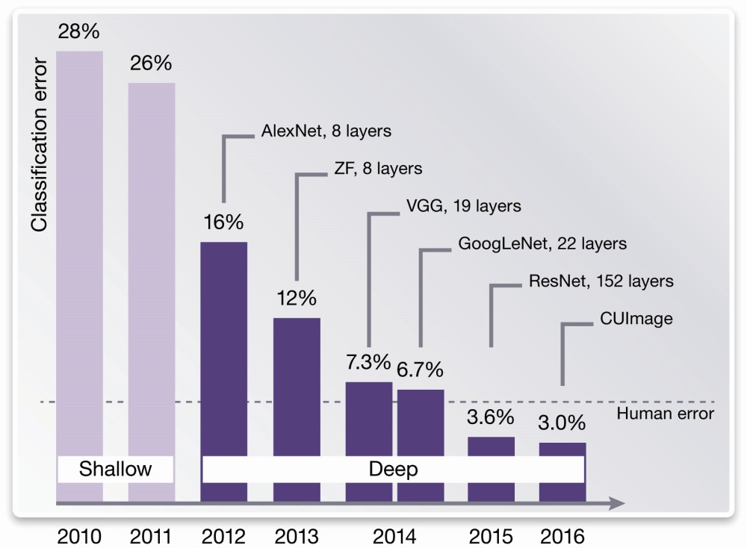

Slide 31
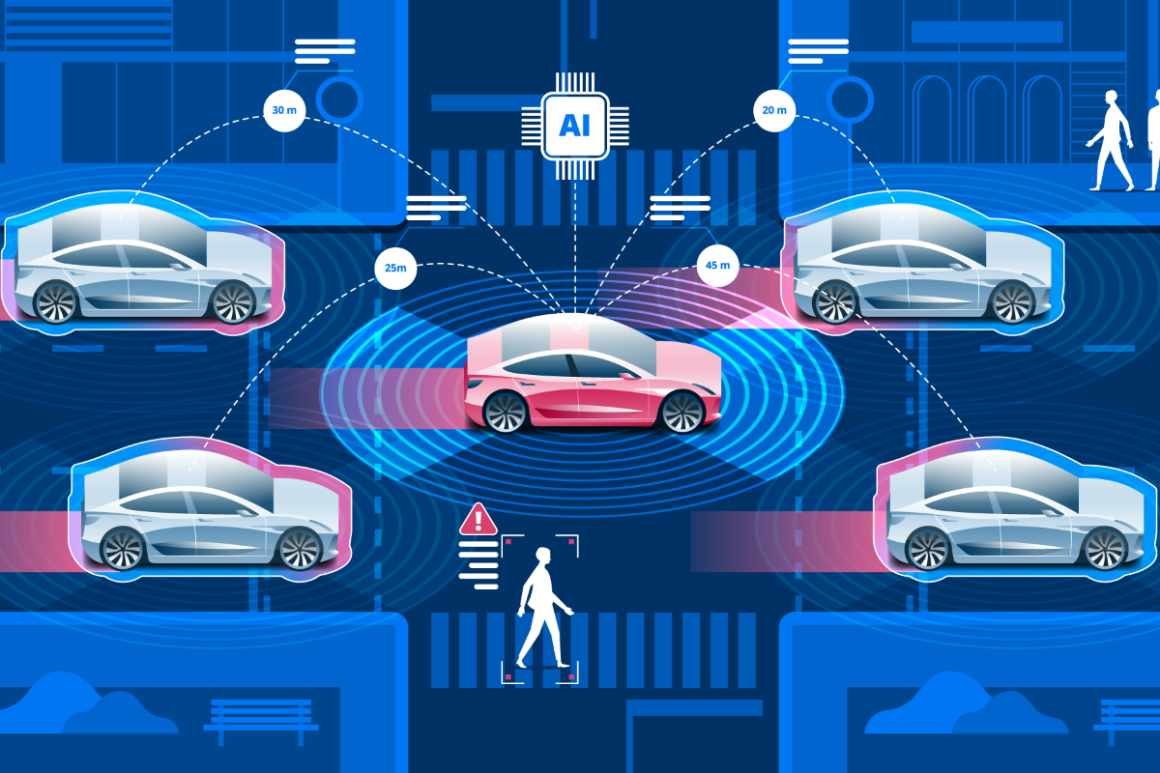
Self-driven Cars

Slide 32
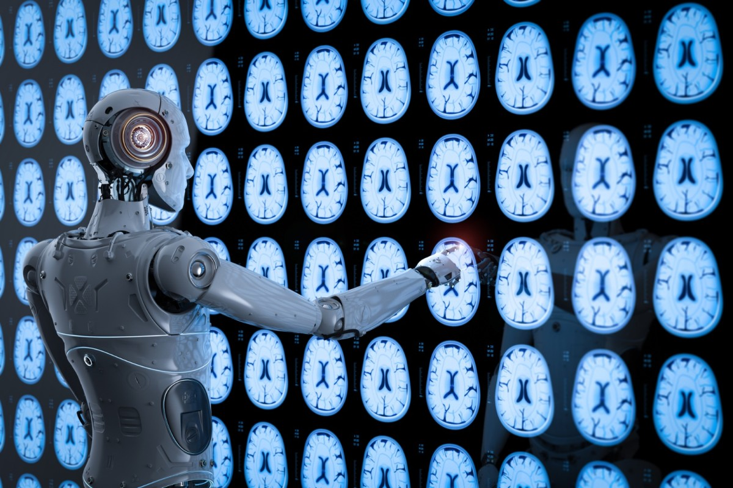
Medical Imaging Automatic Diagnosis

Slide 33
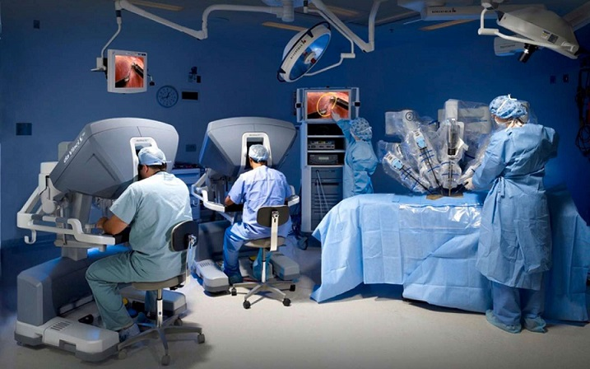
Medical Operations

Slide 34
Deep Neural Network Structures
Attention & Transformers

Slide 35
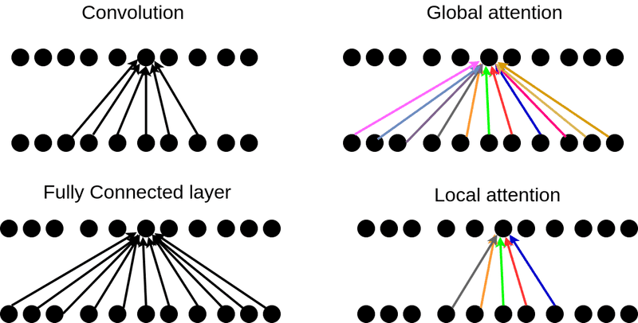
Attention

Slide 36
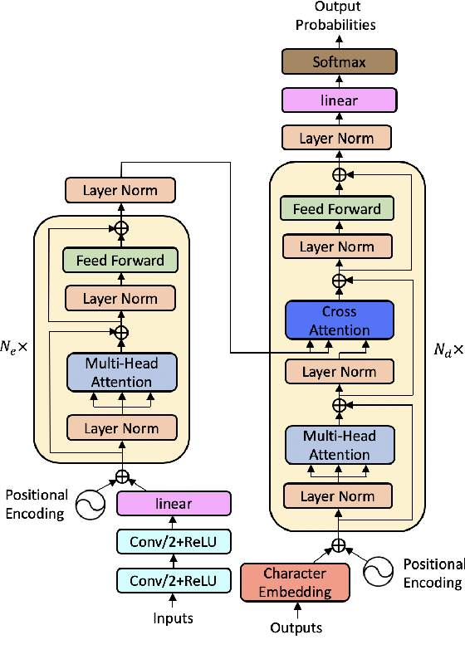
Deep Neural Networks Structures
Transformers

Slide 37
Deep Neural Network Structures
Foundation Models

Slide 38
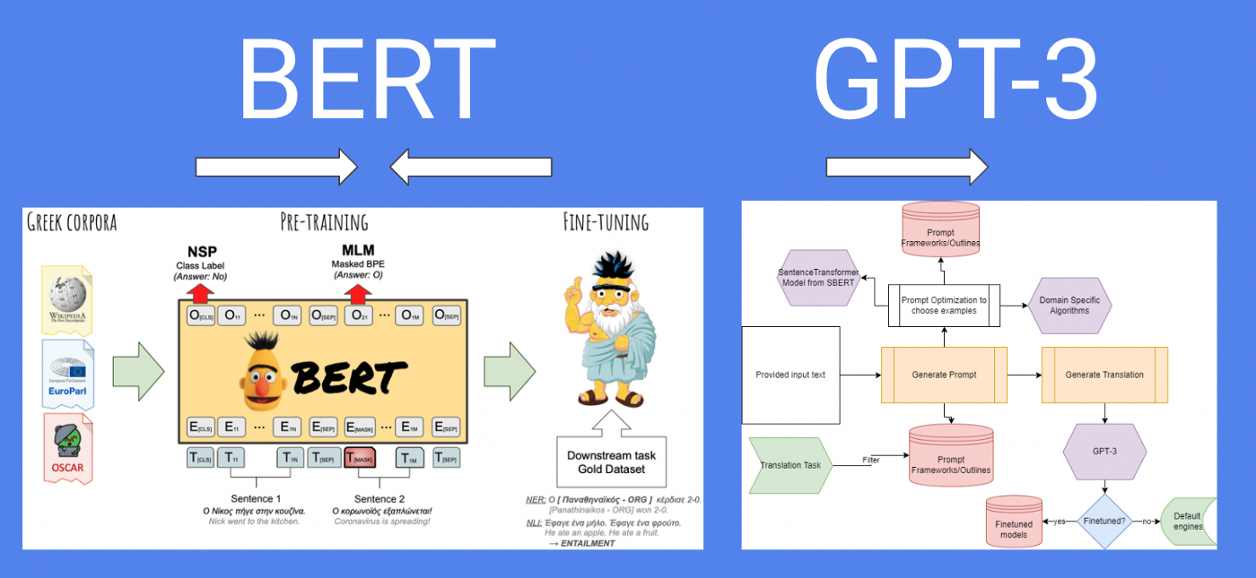
Language Modeling: BERT and GPT Models

Slide 39
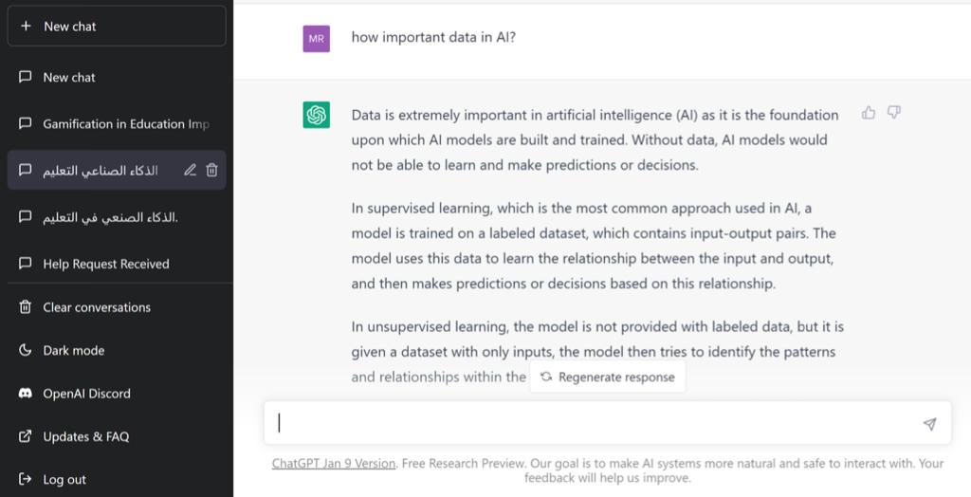
ChatGPT

Slide 40
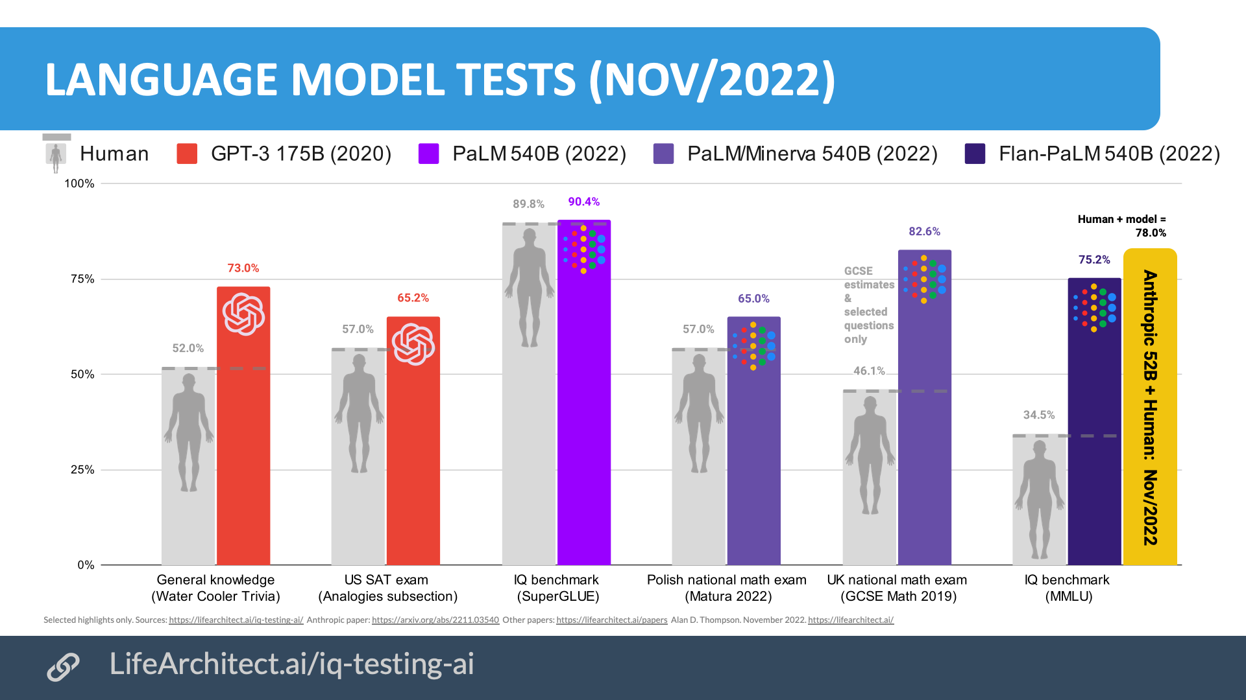
GPT3 ChatGPT

Slide 41
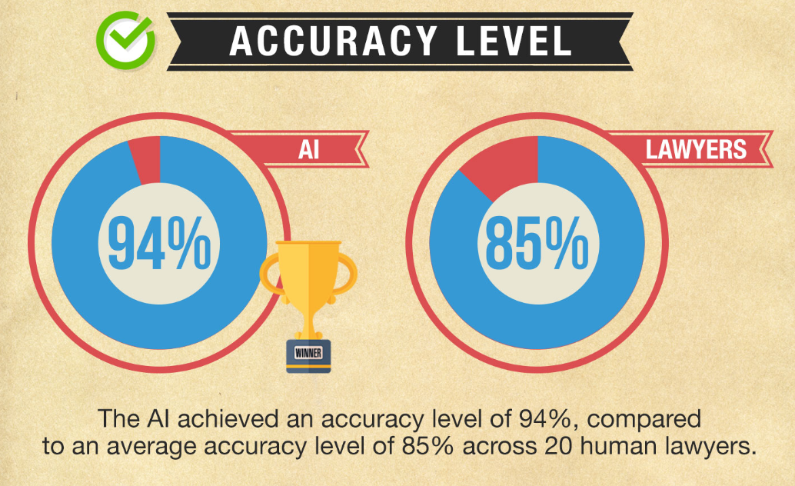

Slide 42
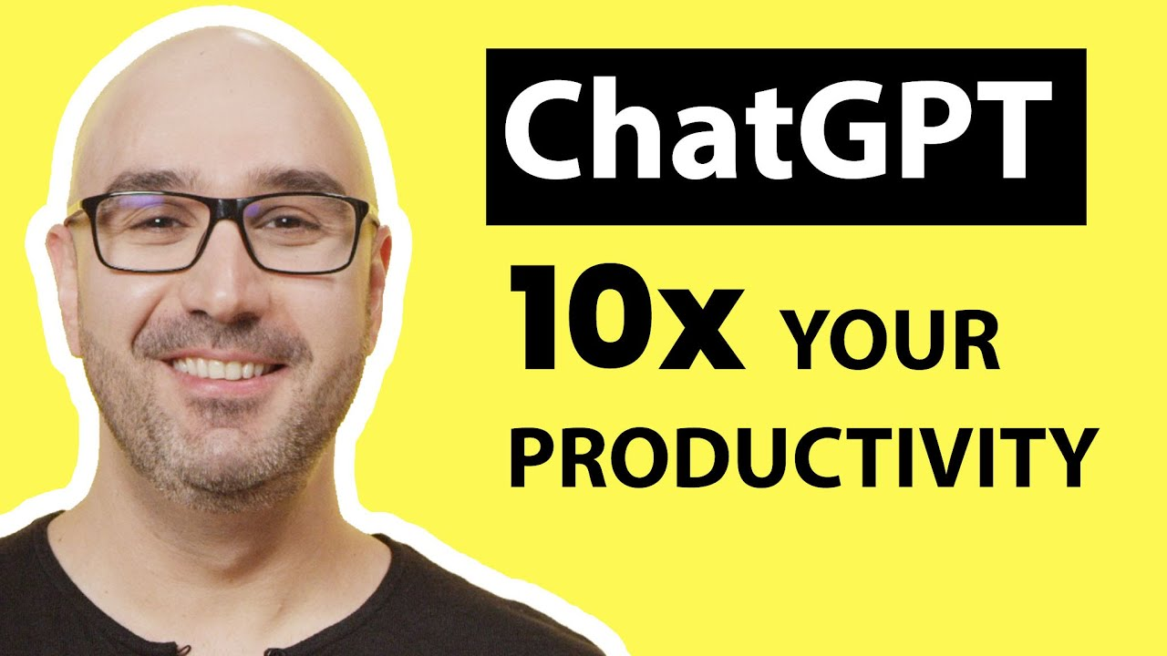
https://www.youtube.com/watch?v=sTeoEFzVNSc

Slide 43
Deep Neural Network Structures
Generative Adversarial network (GAN)

Slide 44
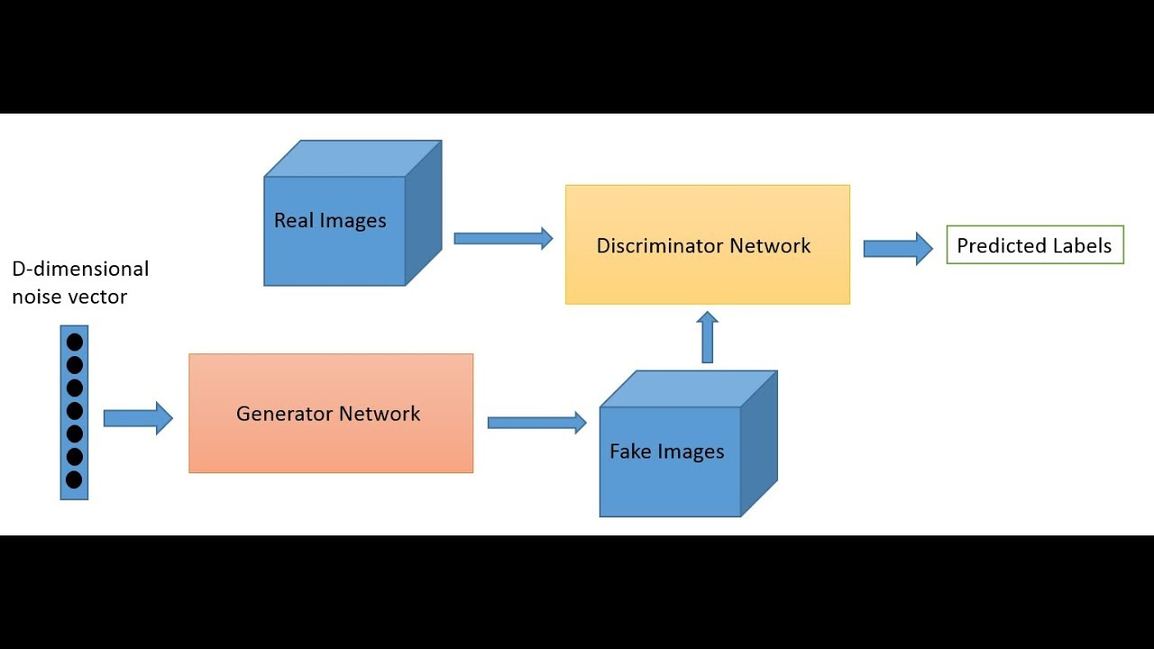
Generative Adversarial network (GAN)

Slide 45
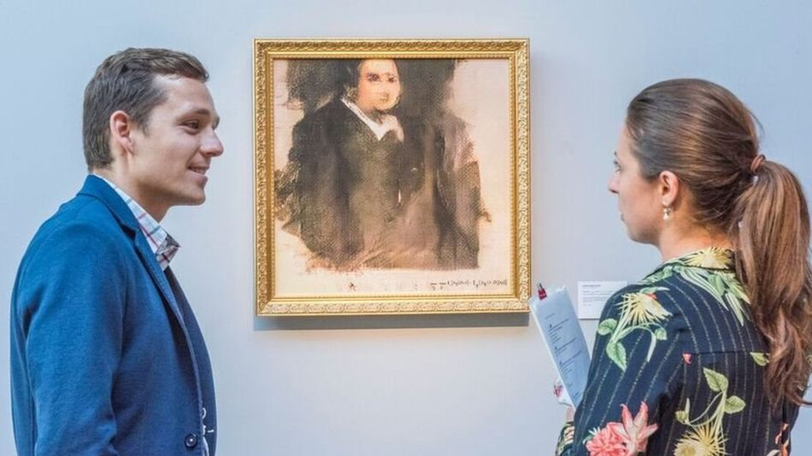
An artwork created by AI (GAN Network) program has been sold at auction for $432,000
Portrait of Edmond Belamy

Slide 46


Slide 47
Course outline

Slide 48
Course outline
Part I: Artificial Neural Networks (4 weeks)
Introduction to NN
Single-layer perceptron
Multilayer perceptron
Back propagation algorithm
Convolutional Neural Network (CNN)
Learning Algorithms: supervised, unsupervised, reinforcement learning
Overfitting and how to avoid it

Slide 49
Course outline
Part-II:
Data Representation and Data reduction techniques: (1 weeks)
  K-means clustering, Gaussian Mixture Model
  Principal Component Analysis
Review of Classical Machine Learning: (1 weeks)
  Review of Machine learning (classical classifiers)
    Regression Models
    KNN, SVM, NBC, …etc.

Slide 50
Course outline
Deep Neural Networks Structures: (4 weeks)
Variants of CNN (ImageNet)
Transformers
Other DNN Models: Auto encoders, GANs Models, Diffusion Models
Natural Language Processing
Applications on DNN: (2 weeks)
Foundation Models
Language Modeling: BERT and GPT
ChatBots: ChatGPT

Slide 51
Course Assessment
Reviewing and presenting a paper 10 Marks
Assignments (mostly Group assignments) 10 Marks
The course project (No midterm exam) 20 marks
Attendance is important

Slide 52
Thank You

Slide 53
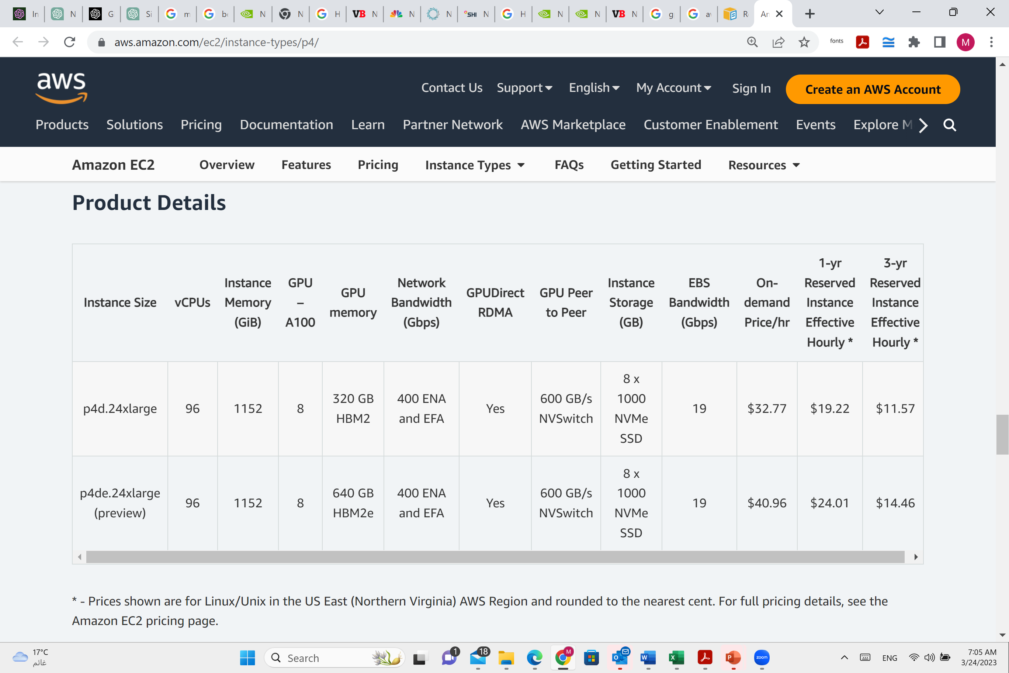

Slide 54
https://aws.amazon.com/ec2/instance-types/p4/

